Slide 1
File Management

Slide 2

File Management in C
Notes:
This presentation demonstrates the new capabilities of PowerPoint and it is best viewed in Slide Show. These slides are designed to give you great ideas for the presentations you’ll create in PowerPoint 2010!
For more sample templates, click the File tab, and then on the New tab, click Sample Templates.

Slide 3
1. Through this lecture, students will learn how to manage files, various operations on file in C programming
Learning
Outcomes

Slide 4
Contents
Data Organization
Types of File
File Modes
Different File Operations

Slide 5
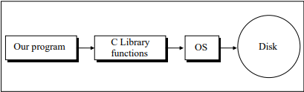
Data Organization
How data is organized on disk?
All data stored on the disk is in binary form.
How this binary data is stored on the disk varies from one OS to another
C programmer has to use only the library functions written for the particular OS to be able to perform input/output.
It is the compiler vendor’s responsibility to correctly implement these library functions by taking the help of OS

Slide 6
C Files
File is a collection of related records stored in a secondary storage of the computer
We use files for storing different information which can be processed by our program
In order to store information permanently, we need to use these files
C allows programmers to read and write to the files when required.
Bytes
.................
..................
file
Header File

Slide 7
File Operations
Creation of new file
Opening an existing file
Reading from file
Writing to a file
Moving to a specific location in a file
Closing a file

Slide 8
Program to open a file
#include <stdio.h>
int main()
{
FILE *fptr;
fptr = fopen("data.dat","r");
if(fptr == NULL)
printf("ERROR: Not able to open the file ");
else
fclose(fptr);
return 0;
}

Slide 9
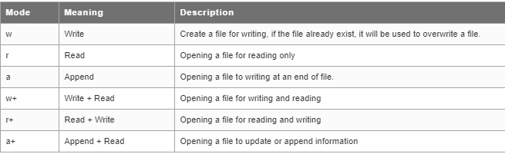
File Opening Modes

Slide 10
Reading a File
Functions to read data from files
fscanf()
used to read the sequence of characters, integers, floats, etc. from a file by using appropriate format specifier of data type.
fgets()
The fgets() function used to read a string from a file.
fgetc()
used to read a single character from a file. It can read only one character at a time.

Slide 11
Program to read contents of file using fscanf()
#include <stdio.h>
int main()
{ FILE *fptr; //File pointer declaration
char name[40], name1[40];
fptr = fopen("record.txt", "r+"); //the function fopen opens the record text file
printf("\nEnter your name : ");
scanf("%s", name);
fputs(fptr,name); //the entered name is written in to the file
rewind(fptr); //returns pointer to the starting point of the file
fscanf(fptr, "%s ", name1); //reads the name from file
printf("Name reads from File : %s", name1);
fclose(fptr); //the function closes the opened file
return 0;
}
Output
Enter your name : Amit
Name reads from File : Amit

Slide 12
Program to read a file using fgetc
# include "stdio.h"
main( )
{
FILE *fp ;
char ch ;
fp = fopen ( "PR1.C", "r" ) ;
while( 1 )
{
ch = fgetc ( fp ) ;
if ( ch == EOF )
break ;
printf ( "%c", ch ) ;
}
fclose ( fp ) ;
}
File Pointer used to access a file
Function to open a file
Function to close a file

Slide 13
Program to read contents of file using fgets()
#include <stdio.h>
int main()
{ FILE *fptr; //File pointer declaration
char name[40];
fptr = fopen("record.txt", "w"); //the function fopen opens the record text file
printf("\nEnter your name : ");
scanf("%s", name);
fputs(name, fptr);
rewind(fptr);
fgets (name1, 40, fptr ); //reads the string from the file
printf("Name : %s", name1);
fclose(fptr); //the function closes the opened file
return 0;
}
Output
Enter your name : Amit
Name : Amit

Slide 14
Writing to a File
Functions to write data to file
fprintf()
The fprintf() function is used to write sequence of characters, integers, floats, etc. by using appropriate format specifier specified data type.
fputs()
used to write sequence of characters into file without the opened file.
fputc()
used to write into an opened file. But it writes a single character at a time.

Slide 15
Program to write contents of file using fprintf()
#include <stdio.h>
int main()
{ FILE *fptr; //File pointer declaration
char name[40];
int age;
fptr = fopen("record.txt", "w "); //the function fopen opens the record text file
printf("\nEnter your name : ");
scanf("%s", name);
printf("\nEnter your age : ");
scanf("%d",&age);
fprintf(fptr,"%s", name); //the entered name is written in to the file
fprintf(fptr,"%d ", age); //the entered age is written to the file
fclose(fptr); //the function closes the opened file
return 0;
}
Output
Enter your name : amit
Enter your age : 20

Slide 16
Program to write a file using fputc
#include <stdio.h>
int main()
{ FILE *fptr; //File pointer declaration
char ch;
fptr = fopen("record.txt", "a "); //the function fopen opens the record text file
printf("\nEnter characters with a space to write into a file press 'y 'to stop writing : ");
scanf("%c",&ch);
while(ch != 'y')
{
fputc(ch, fptr);
scanf("%c",&ch);
}
fclose(fptr); //the function closes the opened file
return 0;
}
Output
Enter characters with a space to write into a file press 'y 'to stop writing : f u n y

Slide 17
Program to write a file using fputs
#include <stdio.h>
int main()
{
FILE *fptr; //File pointer declaration
char name[40], city[40];
fptr = fopen("record.txt", "w "); //the function fopen opens the record text file
printf("\nEnter your name : ");
scanf("%s", name);
printf("\nEnter your city : ");
scanf("%s", city);
fputs(fptr,name); //the entered name is written in to the file
fputs(fptr,city); //the entered age is written to the file
fclose(fptr); //the function closes the opened file
return 0;
}
Output
Enter your name : Amit
Enter your city : Delhi

Slide 18
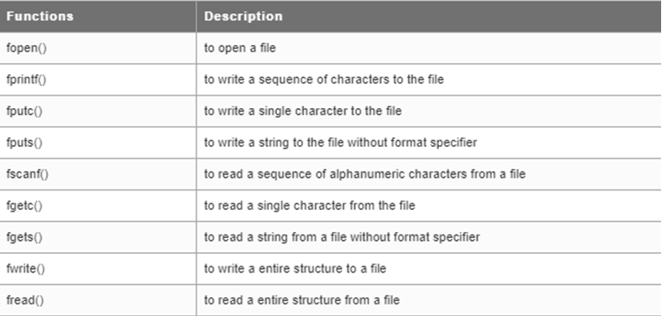
Functions to access a file

Slide 19
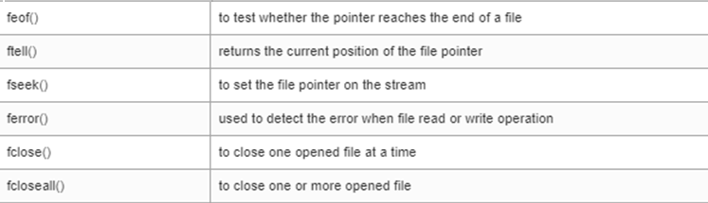
Functions to access a file

Slide 20
Other File Handling Functions
fseek()
used to positioning the file pointer in a file.
feof()
used to find whether the file pointer reaches the end of a file or not.
ftell()
used to return a current position of a file pointer
rewind()
used to return a file pointer to the beginning of a file
Three arguments: file pointer, integer value to reposition a file pointer to forward or backward direction and current position of file pointer.
It returns non-zero value when the pointer reaches the end of file

Slide 21
Program to visualize fseek()
#include <stdio.h>
int main()
{ char ch[100];
FILE *fptr; //File pointer declaration
fptr = fopen("info.txt", "w+ "); //the function fopen opens the text file
fputs("This is fseek", fptr);
fseek(fptr, 5, 0);
fgets(ch, 50, fptr);
printf("\nAfter file seek :\n ");
printf("%s", ch);
fclose(fptr); //the function closes the opened file
return 0;
}
After file seek :
is fseek

Slide 22
Program to visualize feof()
#include <stdio.h>
int main()
{ FILE *fptr; //File pointer declaration
fptr = fopen("info.txt", "r+ "); //the function fopen opens the text file
fputs("This is feof", fptr);
rewind(fptr);
while(1)
{ ch = fgetc(fptr);
if(feof(fptr))
{ printf("\nEnd of file reached ");
break; }
printf("%c ", ch);
}
fclose(fptr); //the function close a opened file return 0;
}
This is feof End of file reached

Slide 23
Program to visualize ftell()
#include <stdio.h>
int main()
{ FILE *fptr; //File pointer declaration
fptr = fopen("info.txt", "r+ "); //the function fopen opens the text file
fputs("This function returns the current position of pointer", fptr);
rewind(fptr);
printf("%d ", ftell(fptr));
fseek(fptr, 5, 1);
printf("\n%d ", ftell(fptr));
return 0;
}
0
5

Slide 24
Program to visualize rewind()
#include <stdio.h>
int main()
{ FILE *fptr; //File pointer declaration
char ch;
fptr = fopen("info.txt", "r+ "); //the function fopen opens the text file
fputs("This is rewind", fptr);
rewind(fptr);
while(1)
{ ch = fgetc(fptr);
if(feof(fptr))
{ printf("\nEnd of file reached ");
break; }
printf("%c ", ch);
}
fclose(fptr); //the function closes the opened file
return 0;
}
This is rewind
End of file reached

Slide 25
Error Handling
C Error Handling
ferror() function
used to detect error while reading or writing a file.
perror() function
used to display errors which are specified by compilers.

Slide 26
Implement using perror
#include <stdio.h>
int main()
{
char ch[100];
FILE *fptr; //File pointer declaration
fptr = fopen("info1.txt", "r "); //the function fopen opens the text file
if(fptr == NULL)
{
perror("folk text file ");
}
fclose(fptr); //the function closes the opened file
return 0;
}
folk text file:No such file or directory

Slide 27
Implement using ferror
#include <stdio.h>
int main()
{
char ch[100];
FILE *fptr; //File pointer declaration
fptr = fopen("info.txt", "w "); //the function fopen opens the text file
fputs("This function is used to change the position of file pointer", fptr);
fseek(fptr, 5, 0);
fgets(ch, 50, fptr);
if(ferror(fptr))
printf("\nError:Reading a file is not allowed in write mode. ");
fclose(fptr); //the function closes the opened file
return 0;
}
Error:Reading file not allowed.

Slide 28
C program to create a file called emp.rec and store information about a person, in terms of his name, age and salary.
#include <stdio.h>
void main()
{ FILE *fptr;
char name[20];
int age; float salary;
fptr = fopen ("emp.rec", "w"); /* open for writing*/
if (fptr == NULL)
{ printf("File does not exists \n");
return; }
printf("Enter the name \n");
scanf("%s", name);
fprintf(fptr, "Name = %s\n", name);
printf("Enter the age \n");
scanf("%d", &age);
fprintf(fptr, "Age = %d\n", age);
printf("Enter the salary \n");
scanf("%f", &salary);
fprintf(fptr, "Salary = %.2f\n", salary);
fclose(fptr);
}
Enter the name raj
Enter the age 40
Enter the salary 4000000

Slide 29
C Program to Find the Number of Lines in a Text File
/* C Program to count the Number of Lines in a Text File */
#include <stdio.h>
#define MAX_FILE_NAME 100
int main()
{ FILE *fp;
int count = 0; // Line counter (result)
char filename[MAX_FILE_NAME];
char c; // To store a character read from file
// Get file name from user. The file should be
// either in current folder or complete path should be provided
printf("Enter file name: ");
scanf("%s", filename);
// Open the file
fp = fopen(filename, "r");
// Check if file exists
if (fp == NULL)
{
printf("Could not open file %s", filename);
return 0;
}
// Extract characters from file and store in character c
for (c = getc(fp); c != EOF; c = getc(fp))
if (c == '\n') // Increment count if this character is newline
count = count + 1;
// Close the file
fclose(fp);
printf("The file %s has %d lines\n ", filename, count);
return 0;
}

Slide 30
Quiz

Slide 31
#include<stdio.h>
int main()
{ int EOF = 0;
printf("%d", EOF);
return 0;
}
A. -1 B. 0 C. 1 D. Compilation Error
2. Which of the following true about FILE *fp
A. FILE is a keyword in C for representing files and fp is a variable of FILE type.
B. FILE is a structure and fp is a pointer to the structure of FILE type
C. FILE is a stream
FILE is a buffered stream
3. getc() returns EOF when
A. End of files is reached
B. When getc() fails to read a character
C. Both of the above
D. None of the above

Slide 32
4. In fopen(), the open mode "wx" is sometimes preferred "w" because. 1) Use of wx is more efficient. 2) If w is used, old contents of file are erased and a new empty file is created. When wx is used, fopen() returns NULL if file already exists.
Only 1 B. Only 2 C. Both 1 and 2 D. Neither 1 nor 2
5. fseek() should be preferred over rewind() mainly because
A. rewind() doesn't work for empty files
B. rewind() may fail for large files
C. In rewind, there is no way to check if the operations completed successfully
All of the above
6. #include<stdio.h>
int main()
{ printf("%d", EOF);
return 0; }
A. NULL B. -1 C. 0 D. Compilation Error
7. If fopen() functions is not able to open a file, it will returns?
A. Compilation Error B. 0 C. EOF D. NULL

Slide 33
8. What will be the output of the C program?
/*This program uses two files*/
#include<stdio.h>
int main()
{ char ch;
FILE *fptr1, *fptr2;
fp = fopen("datafile1.txt", "w");
fp = fopen("datafile2.txt", "w");
printf("Thank you.");
fclose(*fptr1, *fptr2);
return 0; }
A. Thank you B. Prints nothing C. Compilation error D. None of the above
9. fopen() function will not opens ______
bin files B. c files C. txt files D. None of the above
10. In C, when getc() function returns EOF?
A. Never Returns B. End of files is reached C. When getc() fails to read a character D. Both B and C

Slide 34
Thank You......

